Slide 1
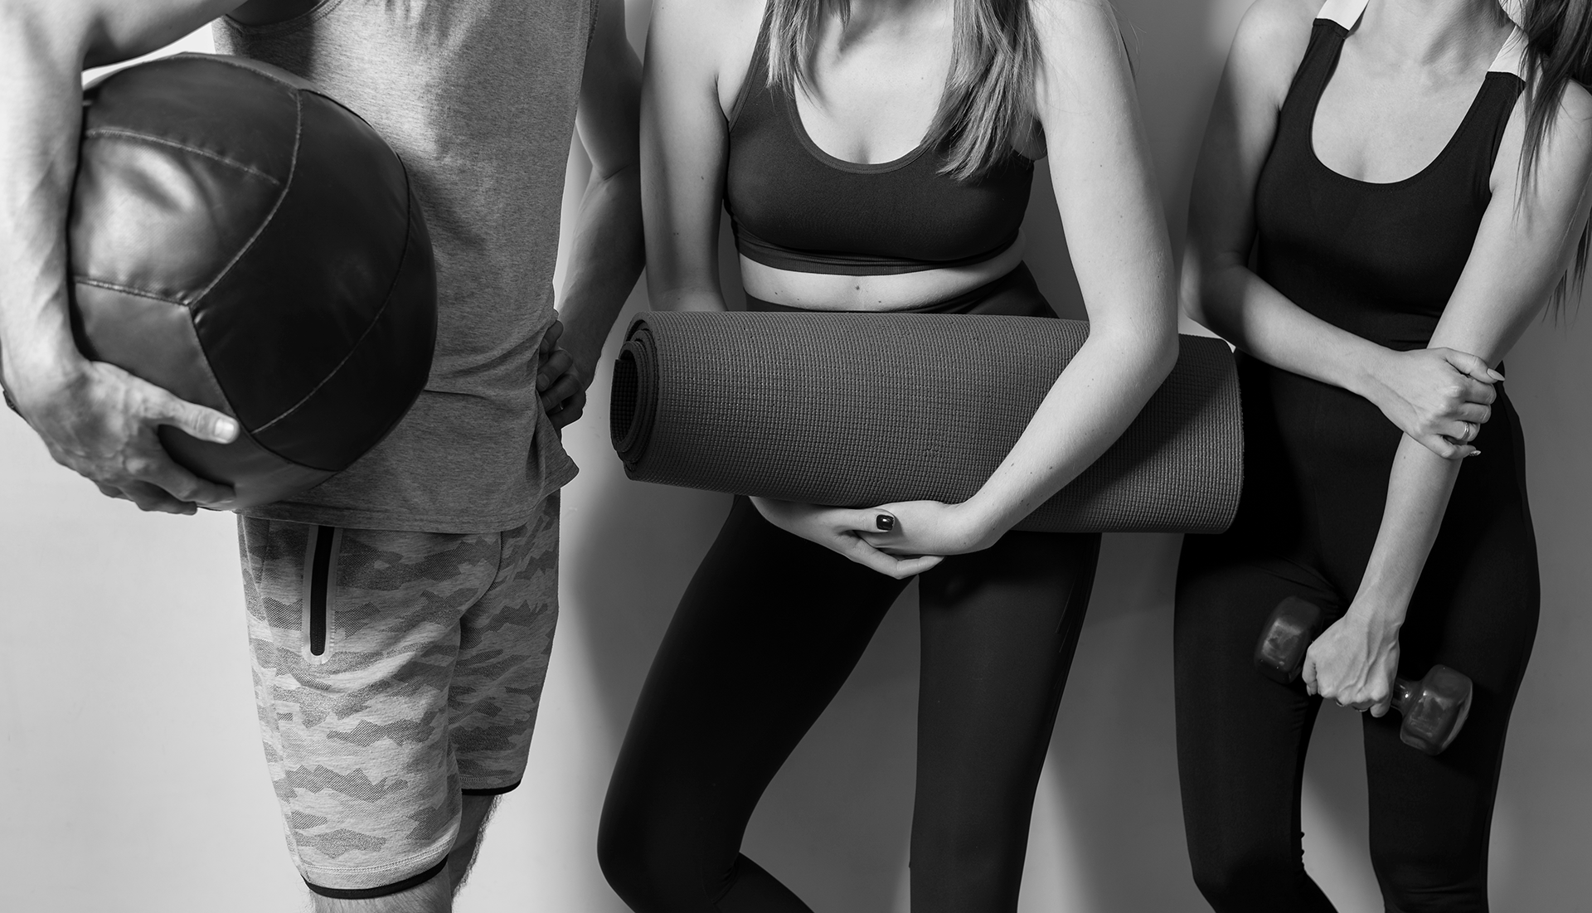
Gastric Sleeve Journey
By: Kelsey Woods

Slide 2
TABLE OF CONTENTS
01
03
02
04
What?
Why?
What is gastric sleeve?
Why is gastric sleeve necessary (in some cases) & interesting
Data
Methods
Where am I getting my data?
Is it ethical research?
How do I plan to analyze the data?

Slide 3
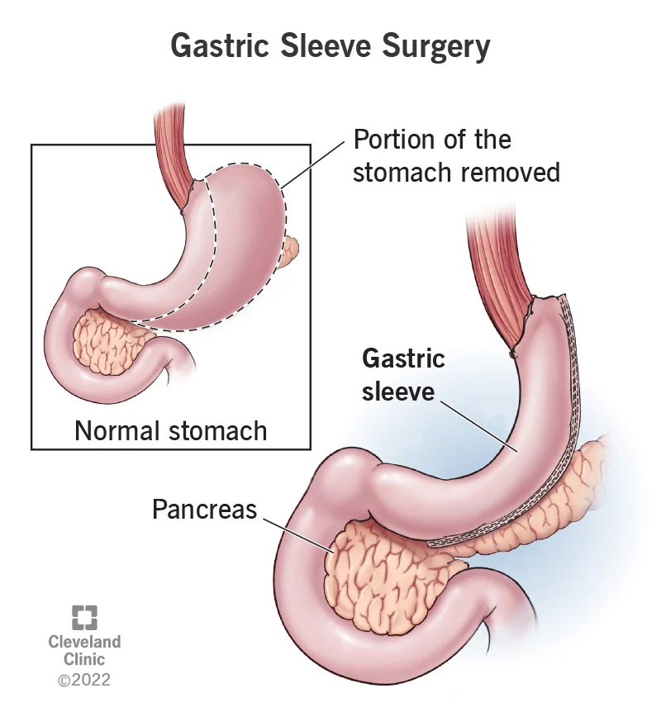
INTRODUCTION
“Gastric sleeve surgery, also called sleeve gastrectomy, is a bariatric surgery procedure. It removes a large portion of your stomach, leaving behind a narrow “sleeve.” Reducing your stomach helps restrict calories and reduce hunger signals. This surgery is offered to help people with clinically severe obesity achieve effective weight loss” (Cleveland Clinic).

Slide 4
What Are the Reasons?
Insulin Resistance
Hypertension
High Cholesterol
Fatty Liver
Obstructive sleep apnea

Slide 5
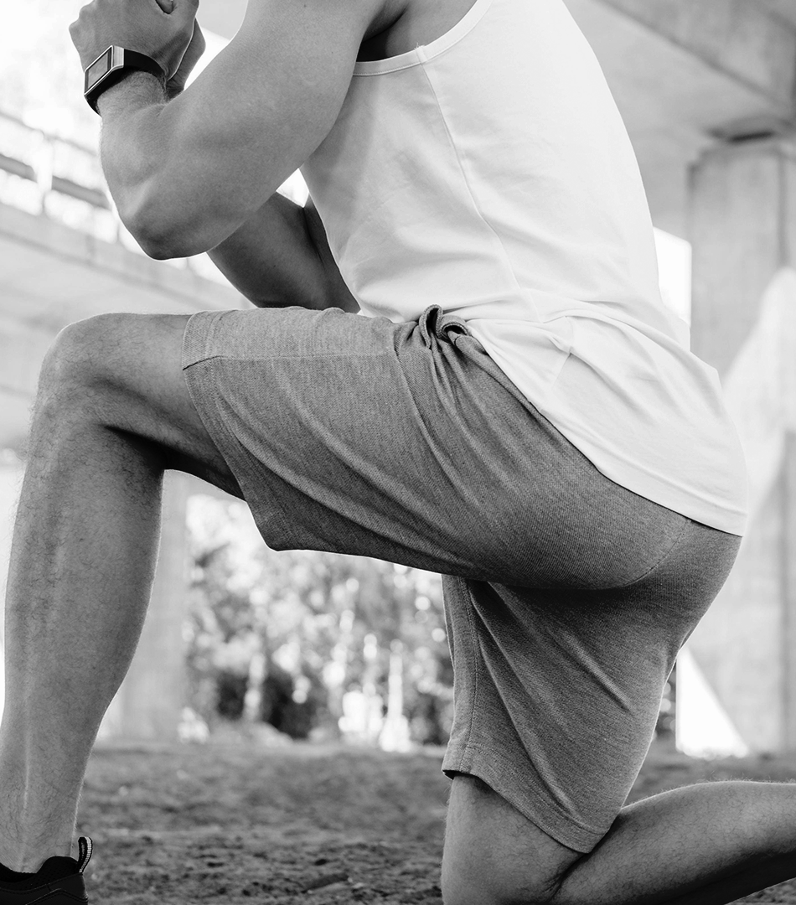
Why is this interesting?
Lack of Research
I was unable to find any research on day to day or even week to week weight loss trends for this surgery
Lack of Data Science usage
I also found no one using data science to predict these trends
Self discovery
I would like to know where my health is trending based on the surgery I have received

Slide 6

METHODS
MERCURY
MARS
Mercury is the closest planet to the Sun
Despite being red, Mars is a very cold planet
Venus has a beautiful name, but it’s terribly hot
Saturn is the only planet with rings
VENUS
SATURN

Slide 7
Is this ethical?
Yes, I went into the surgery understanding the process and what was required of me but was not instructed on the timeline of benefits or what was going to happen. This would have made the difficult part of the surgery easier to manage and would provide a “guide” for what others could expect post-surgery

Slide 8
Is this ethical?
A downside is others could use this as a manual rather than a guide. I will make it clear throughout the process that this data is meant to give an idea of what to expect and emphasize demographics so it is less likely to be abused.

Slide 9
Data
8/25/2023 | 258.6 | 67 | 0 | 0 | 11.4 | 40.49806193 | Severe Obesity | 48.0 | 51.0 | 48.0 | 60 | Walk | Liquids
8/26/2023 | 258.0 | 67 | 0.6 | 0.6 | 12.0 | 40.40409891 | Severe Obesity | 48.0 | 50.8 | 47.8 | 60 | Walk | Liquids
8/27/2023 | 256.8 | 67 | 1.2 | 1.8 | 13.2 | 40.21617287 | Severe Obesity | 47.7 | 50.5 | 47.5 | 60 | Walk | Liquids
8/28/2023 | 255.0 | 67 | 1.8 | 3.6 | 15.0 | 39.9342838 | Class 2 Obesity | 47.4 | 50.3 | 47.1 | 60 | Walk | Liquids
8/29/2023 | 254.3 | 67 | 0.7 | 4.3 | 15.7 | 39.82466028 | Class 2 Obesity | 47.3 | 50.3 | 47.0 | 60 | Walk | Liquids
8/30/2023 | 251.7 | 67 | 2.6 | 6.9 | 18.3 | 39.41748719 | Class 2 Obesity | 46.9 | 50.0 | 46.7 | 60 | Walk | Liquids
8/31/2023 | 247.7 | 67 | 4.0 | 10.9 | 22.3 | 38.79106705 | Class 2 Obesity | 46.6 | 49.8 | 46.3 | 60 | Walk | Liquids

Slide 10

Methodology
I plan on using new packages I have found on LinkedIn to perform a time series analysis and machine learning predictive analysis

Slide 11
Classes That Taught Me for this project:
CS 661 Python Programming
CS 660 Mathematical Foundations of Analytics
CS 675 Introduction to Data Science
CS 619 Data Mining
CS 676 Algorithms
CS 677 Machine Learning

Slide 12
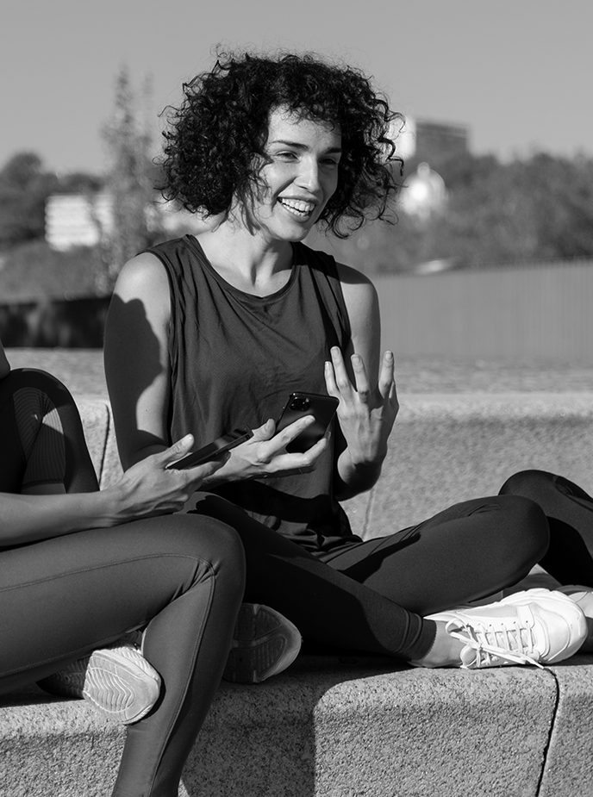
CONCLUSIONS
Data science has been slowly breaking into clinical research, but has yet to touch this area of bariatric surgery
I would like to see what can be expected for this surgery to help not only myself but others

Slide 13
THANKS!
Do you have any questions?
youremail@freepik.com
+91 620 421 88
yourcompany.com
Please keep this slide for attribution

